Slide 1
The Demographics of an Aging Society: Impact on US Healthcare
Dr. Kim Kuebler, DNP, APRN, ANP-BC
Assistant Program Director, College of Nursing
South University Online

Slide 2
Aging World 2015
International Population Reports
Released March, 2016
The US Department of Health and Human Services, National Institutes of Health, National Institutes of Aging, US Census Bureau and the US Department of Commerce, Economics and Statistics Administration released the
An Aging World 2015: International Population Reports

Slide 3
Aging World 2015
International Population Reports
The developed world’s population is aging rapidly. Currently, the older population (aged 65 and over) represent 7 percent or more of the total population in many parts of the world
GROWTH OF WORLD’S OLDER POPULATION WILL CONTINUE TO OUTPACE THAT OF YOUNGER POPULATION OVER THE NEXT 35 YEARS
He, W., Goodkind, D., & Kowal, P. (2016). An Aging World 2015: International Population Reports. US Department of Commerce

Slide 4
Aging World 2015
International Population Reports
In 2015 of the 7.3 billion people worldwide there is 8.5 percent, or 617.1 million, people aged 65 and older
The number of older people worldwide is projected to increase more than 60 percent in the next 15 years
In 2030, there will be about 1 billion older people globally, equivalent to 12.0 percent of the total population.
He, W., Goodkind, D., & Kowal, P. (2016). An Aging World 2015: International Population Reports. US Department of Commerce

Slide 5
Aging World 2015
International Population Reports
The majority of the older population will continue to age over the next 20 years
In 2050, there will be 1.6 billion older people globally, representing 16.7 percent of the total world population of 9.4 billion.
This average annual increase is equivalent to 27.1 million older people from between 2015 to 2050
He, W., Goodkind, D., & Kowal, P. (2016). An Aging World 2015: International Population Reports. US Department of Commerce

Slide 6
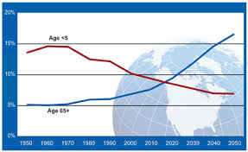
Aging World 2015
International Population Reports

Slide 7

Aging World 2015
International Population Reports
The oldest segment of the world’s population is exponentially growing faster than the younger segment –a result of increased life expectancy
Worldwide, the population of people aged 80 and over is projected to more than triple between 2015 and 2050, from 126.5 million to 446.6 million
He, W., Goodkind, D., & Kowal, P. (2016). An Aging World 2015: International Population Reports. US Department of Commerce

Slide 8
Aging World 2015
International Population Reports
Between 1980 to 2010, US census data showed that the 90 and older population almost tripled when compared to a doubling of the population aged 65 to 89
Centenarians or people older than 100, increased by 65.8 percent in the US during the same period of time
He & Mucenchrath, 2011; Meyer, 2012

Slide 9
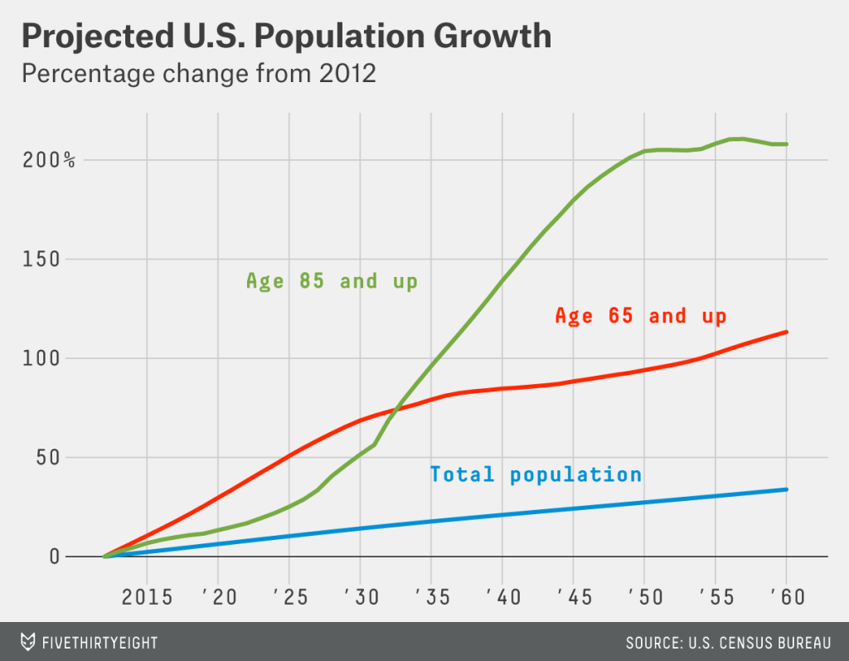
US Aging Demographics

Slide 10
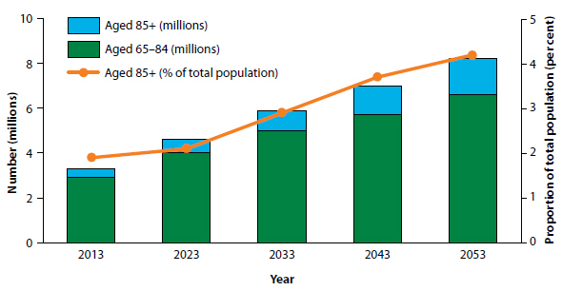
US Aging Demographics

Slide 11

Aging World 2015
International Population Reports
The aged people in the US are distinct from the rest of the older population in other sociodemographic characteristics.
US population has more chronic conditions that require long-term care, consume public resources disproportionately and create a heavier burden on informal care often provided by families
National Institute on Aging and U.S. Department of State, 2007; Tsai, 2010

Slide 12
Aging World 2015
International Population Reports
The changes occurring in the social structures of aging in most parts of the world have contributed to a growing number of older people with multiple health conditions that interfere with physical functioning and ability to carry out activities of daily living.
He, W., Goodkind, D., & Kowal, P. (2016). An Aging World 2015: International Population Reports. US Department of Commerce

Slide 13
The American Demographics
The United States is in the midst of a major demographic shift.
In the next four decades, people aged 65 and older will make up the largest percentage of the population
Institutes of Medicine (2012)

Slide 14


The US Aging Population
The oldest of the 80 million baby boomers reached age 65 in 2011
Living longer with increased disability
Institute of Medicine, 2012

Slide 15
Medicare Beneficiaries and Multiple Chronic Conditions (MCC)
In patients 65 years and older, three out of four have MCC.
Two out of three Medicare beneficiaries have MCC.
People with MCC are at increased risk for mortality and poorer day-to-day functioning.
MCC account for substantial health care costs in the United States.
Approximately 66 percent of the total health care spending is associated with care for the over one in four Americans with MCC.
Centers for Medicare and Medicaid, 2015

Slide 16
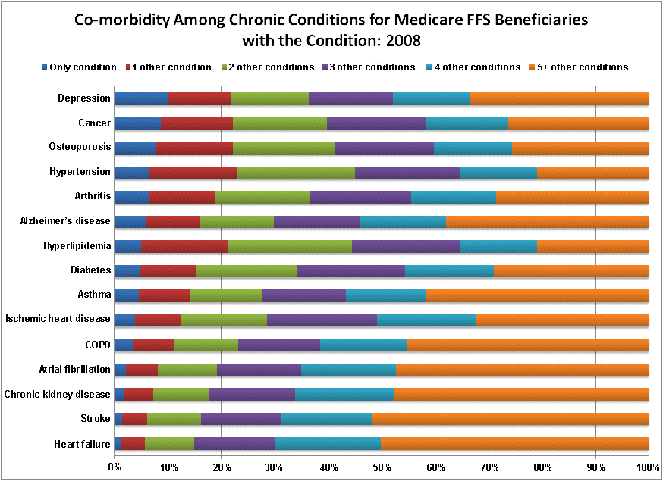
Source: Centers for Medicare and Medicaid Services. Chronic Conditions among Medicare Beneficiaries, Chart book. Baltimore, MD. 2011.
Notes:
Figure 1.2.
Data highlights:
Seven percent of beneficiaries with hypertension had no other condition present, while 21% had 5 or more additional conditions.
Stroke and heart failure were highly co-morbid conditions with about 50% of beneficiaries with these conditions having 5 or more additional chronic health conditions.
This pattern of co-morbidity held for men and women, with beneficiaries 65 years and older and dual-eligible having greater co-morbidity.

Slide 17
Aging World 2015
International Population Reports
America is identified in this report as the American Wealthhealth Paradox, one of the wealthiest larger countries but not the healthiest.
Smoking, obesity and hypertension contribute to the increase in female mortality over men.
American men and women living in the poorer southern states have lower health, life expectancy than elsewhere in the US.
He, W., Goodkind, D., & Kowal, P. (2016). An Aging World 2015: International Population Reports. US Department of Commerce

Slide 18
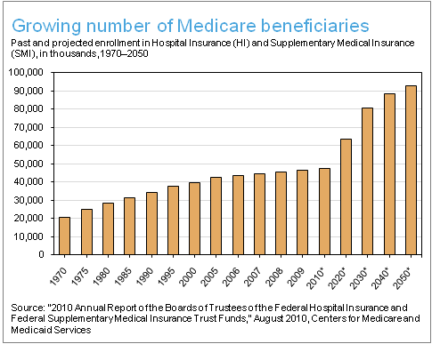
Escalating Medicare Beneficiaries

Slide 19

Affordable Care Act
111TH CONGRESS
2d Session
COMPILATION OF PATIENT
PROTECTION AND AFFORDABLE
CARE ACT HEALTH-RELATED
PORTIONS OF THE HEALTH CARE
AND EDUCATION
RECONCILIATION ACT OF 2010
PREPARED BY THE
Office of the Legislative Counsel
FOR THE USE OF THE U.S. HOUSE OF
REPRESENTATIVES
The Patient Protection and Affordable Care Act
May, 2010

Slide 20
ACA TITLE IV
TITLE IV—PREVENTION OF CHRONIC DISEASE AND IMPROVING PUBLIC HEALTH
Affordable Care Act. 2010

Slide 21
Most Frequent use of Healthcare Resources
CHRONIC EXACERBATIONS
Congestive Heart failure
Chronic Obstructive Pulmonary Disease
POORLY MANAGED DISEASE and SYMPTOMS
Centers for Medicare and Medicaid, 2015; Institutes of Medicine, 2012

Slide 22

Concomitant Conditions & Symptoms
Prolonged course of illness and disability that occur from MCCs are concomitant to symptoms such as pain, depression, dyspnea and fatigue
Kuebler, 2015

Slide 23

Concomitant Conditions & Symptoms
If symptoms are under-treated, they can lead to a decrease in quality of life, increase in disease exacerbations, frequent hospitalizations and costly care for millions of Americans
Kuebler, 2015

Slide 24
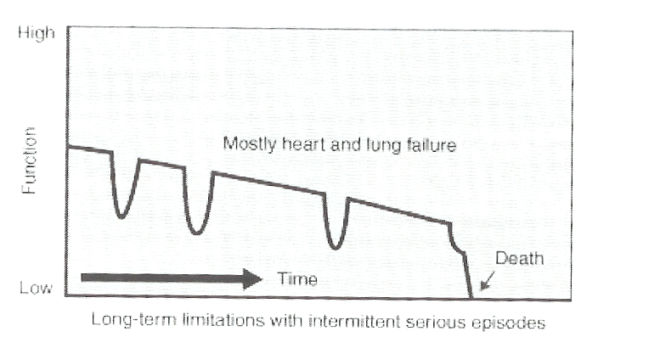
Chronic Disease Trajectory
CHF and COPD Exacerbations

Slide 25
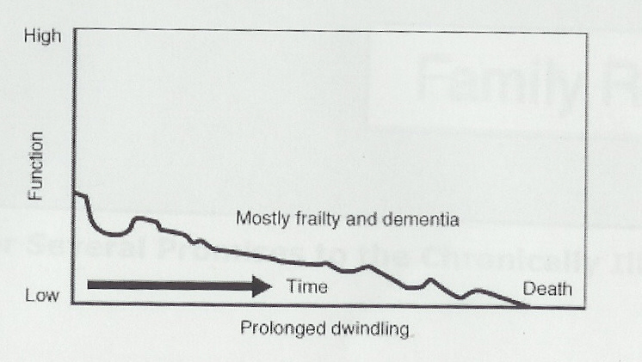
Chronic Disease Trajectory
Alzheimer's and Dementia

Slide 26

National Quality Forum Quality Measures
National Measurements for Quality Care
2012 Separated Palliative Care from End of Life Care
Palliative Care should be integrated sooner in the course of chronic conditions rather than at the end of life to improve symptomatic chronic conditions
National Quality Forum, 2012

Slide 27
National Quality Forum Quality Measures
NQF is home for all endorsed quality measures for primary care providers and specialty who receive Medicare payment. These measures (minimum of 8) must be embedded in a certified Meaningful Use Electronic Health Record
Measures are used to determine value from the provider (MD, NP, PA, Nurse Anesthetist)
Physician Reporting Quality Measures (PQRS), began March, 2016. Providers, practices, systems organizations will be penalized for not submitting quality measures
Centers for Medicare and Medicaid Services, 2016

Slide 28

Chronic Care Model - Reimbursement
Endorsed Quality Measures
Tools
Support
Measureable
Regulated
Quality Driver
Incorporate Guidelines

Slide 29
The Chronic Care Management Code
List of Elements “typically included” in a Patient-Centered Care Plan
Problem list; expected outcome and prognosis; measureable treatment goals
Symptom management and planned interventions (including preventive care)
Community/social services
Plan for care coordination with other providers
Medication management
Responsible individual for each intervention
Requirements for periodic review/revision

Slide 30
Geriatric Medical Care
Continuity
Reliability, 24/7 to the end of life
Enabling self-management around disabilities
Respecting and including family and other caregivers
Attend to the burden of medical care
Move services to the home
Prevent falls, wrong actions
Enhancing relationships, activities, meaningfulness
Enduring with persons living with dementia

Slide 31
Steps in Optimal Care Planning
Targeting
Care Planning
  Current patient/family situation
  Likely future situation(s) with various strategies
  Patient/family priorities – hopes, fears, values – goals
  Negotiated, patient-driven care plan
  Available to those who need it, promptly
Evaluation and Feedback – system learning
Care plan use in system management – supply and quality issues for community

Slide 32
What Matters to Costly Patients in Medicare: Elders Living with Illness and Disability?
Relationships – family, friends, spirituality
Control, finances, dignity, respect
Familiarity, meaningfulness, significance
Comfort
Confidence
Survival time
What do we measure?

Slide 33
What do we Measure in Nursing Homes?
Moderate to severe pain
New or worsened pressure ulcers; any pressure ulcers
Flu and pneumococcal vaccine
New anti-psychotic medication; any antipsychotic medication
Increasing need for ADL help
Weight loss
Losing control of bowel or bladder
Urinary catheters
UTIs
Depression
Restraints
Falls with injury
National Care Quality Assessment, 2016

Slide 34
What do we Measure in Home Care?
Improved mobility
Improved bathing
Improved breathing
Improved wounds
Improved understanding of medications
How often the home care team checked on various things
How often – hospitalization, ER use, readmissions
Patient rating of overall care, professionalism, communication
National Care Quality Assessment, 2016

Slide 35
CMS Reimbursement Ruling
April 27th, 2016 The US Department of Health and Human Services Issued a Proposal to Align and Modernize how Medicare Payments Are Tied to the Cost and Quality of Patient Care

Slide 36
CMS Reimbursement Ruling
CMS released the long awaited proposed ruling in establishing the new Quality Payment Program:
Framework to include the Merit-based Incentive Payment System (MIPS) and;
Alternative Payment Models (APMs). These policies were established by the Medicare Access and CHIP Reauthorization Act of 2015 (MACRA)
Centers for Medicare and Medicaid, 2016

Slide 37

CMS Reimbursement Ruling
This proposed rule will provide a unified framework called the Quality Payment Program and includes 2 unique paths for providers.
Eligible providers include: physicians, nurse practitioners, physician assistants, certified registered nurse anesthetists.
The Merit-based Incentive Payment System (MIPS)
Advanced Alternative Payment Models (APMs)
Centers for Medicare and Medicaid, 2016

Slide 38
CMS Reimbursement Ruling
Merit-based Incentive Payment System (MIPS)
The MIPS Quality Payment Program first performance period will begin next year in 2017 and will provide CMS with the basis for 2019 payment adjustment. MACRA provides the direction for 3 distinct Medicare quality programs in MIPS to include:
Physician Quality Reporting System;
Value-Based Modifier Program;
Meaningful Use’ of electronic health records
Centers for Medicare and Medicaid, 2016

Slide 39
CMS Reimbursement Ruling
Providers will receive a composite score based on performance in each of four categories. Quality measures from core domains are determined annually, data gained from provider performance on these measures will be transparent and available via on the Physician Compare website
Centers for Medicare and Medicaid, 2016

Slide 40
CMS Reimbursement Ruling
The Four Performance Categories Include:
Quality: 50 percent of total score in year 1;
Advancing Care Information: 25 percent of total score in year 1, previously known as EHR Meaningful Use;
Clinical Practice Improvement Activities: 15 percent of total score in year 1, this domain has recently been added by CMS; and
Cost or Resource Use: 10 percent of total score in year 1, based on Medicare claims data from provider submission
Centers for Medicare and Medicaid, 2016

Slide 41
CMS Reimbursement Ruling
Advanced Alternative Payment Models
The bipartisan MACRA legislation further created the Alternative Payment Model (APM), where providers become qualifying participants who can earn incentives for participation.

Slide 42
CMS Reimbursement Ruling
The Advanced APM must meet 3 MACRA requirements
Use of certified electronic health records (EHRs);
Reimbursement is based upon comparable quality measures; and
Becoming an enhanced medical home or reporting more than nominal risk for losses
Centers for Medicare and Medicaid, 2016

Slide 43
CMS Reimbursement Ruling
APMs must provide CMS with a clear thesis on what measures will be tested, and require a formal provider agreement with CMS.
CMS works individually with each APM to evaluate and assess specific measurements.
CMS will provide transparency to the public on which APMs quality for Advanced APMs prior to each performance period – proposed to begin no later than January 1, 2017.
Centers for Medicare and Medicaid, 2016

Slide 44
References:
Centers for Medicare and Medicaid (2016). Quality Reporting Program. Retrieved https://www.cms.gov/Medicare/Quality-Initiatives-Patient-Assessment-Instruments/Value-Based-Programs/MACRA-MIPS-and-APMs/NPRM-QPP-Fact-Sheet.pdf
Centers for Medicare and Medicaid (2015). Multiple Chronic Conditions. Retrieved https://www.cms.gov/Research-Statistics-Data-and-Systems/Statistics-Trends-and-Reports/Chronic-Conditions/MCC_Main.html
He, W., Goodkind, D., & Kowal, P. (2016). An Aging World 2015: International Population Reports. US Department of Commerce
He, W., & Muenchrath, M. (2011). 90+ in the United States: 2006–2008. American Community Survey Reports, ACS-17, U.S. Census Bureau. Washington, DC: U.S. Government Printing Office.
Institutes of Medicine (2012). Living Well with Chronic Illness: A Call for Public Action. Retrieved http://www.nationalacademies.org/hmd/~/media/Files/Report%20Files/2012/Living-Well-with-Chronic-Illness/livingwell_chronicillness_reportbrief.pdf
Kuebler, K. (2015). National graduate nursing clinical faculty survey: Chronic disease, symptoms disease and self-management. Clinical Scholars Review, 8(2),
Meyer, J. (2012). Centenarians: 2010. 2010 Census Special Reports, C2010SR-03, U.S. Census Bureau. Washington, DC: U.S. Government Printing Office

Slide 45
References
National Care and Quality Assessment (NCQA), 2016. Hedis & Quality Measurement. Retrieved http://www.ncqa.org/HomePage.aspx
National Institute on Aging (NIA) and U.S. Department of State (2007). Why Population Aging Matters: A Global Perspective. National Institute on Aging of National Institutes on Health Publication 07-6134. Washington, DC: National Institute on Aging of National Institutes on Health.
National Quality Forum (2012). NQF Endorses Palliative and End of Life Care Measures. Retrieved https://www.qualityforum.org/News_And_Resources/Press_Releases/2012/NQF_Endorses_Palliative_and_End-of-Life_Care_Measures.aspx
Tsai, T. (2010). More Caregivers Needed Worldwide for the “Oldest Old.” Washington, DC: Population Reference Bureau.

Slide 46

"WHAT DO WE LIVE FOR IF NOT TO MAKE LIFE LESS DIFFICULT FOR EACH OTHER”
-George Eliot-

