Slide 1
MACRA & Chronic Care Management: Are You Ready?
Partners in Patient Care

Slide 2
PRESENTERS:
DR. KIM KUEBLER, DNP, APRN, ANP-BC Founder and Director of Multiple Chronic Conditions Resource Center, editor and author of multiple peer review papers and 8 textbooks on symptomatic chronic conditions. She is a researcher, educator and clinical provider. Kuebler holds several federal appointments to include Medicare Evidence Development & Coverage Advisory Committee

Slide 3
PRESENTERS
Van Willis Co-Founder & CEO PREMEDEX
PREMEDEX is a leader in healthcare transformation and combines data analytics with advanced communication services in order to increase efficiencies, improve patient satisfaction, and positively influence the related outcomes of your patient population
Preston Rodenbaugh
Business development leader and advisor for healthcare transformation. Assist’s providers with extending value based care for Chronic Care Management and Transitional Care Management

Slide 4
OBJECTIVES
Discuss current trends in the Medicare patient population diagnosed with multiple chronic conditions
Review the Medicare reimbursement incentives for chronic care management

Slide 5
OBJECTIVES
Describe how to implement and obtain monthly reimbursement incentives that demonstrate 24/7 patient and family support
Learn how chronic care management can address the requirements for MACRA outcomes and future incentives.

Slide 6
AGING DEMOGRAPHICS
The US is in the midst of a major
demographic shift,
In the next four decades, people aged 65 and older will make up the largest percentage of the population
Centers for Disease Control and Prevention (CDC), 2015

Slide 7
AGING WORLD, 2016
The oldest segment of the world’s population is growing faster than the younger segment
Worldwide, the population of people aged 80 and over is projected to more than triple between 2015 and 2050, from 126.5 million to 446.6 million
He, W., Goodkind, D., & Kowal, P. (2016). An Aging World 2015: International Population Reports. US Department of Commerce

Slide 8
Aging World 2015 International Population Reports
Between 1980 to 2010, US census data showed 90 and older population almost tripled when compared to a doubling of the population aged 65 to 89
Centenarians or people older than 100, increased by 65.8 percent in the US during the same period of time
He, W., Goodkind, D., & Kowal, P. (2016). An Aging World 2015: International Population Reports. US Department of Commerce

Slide 9
Aging World

Slide 10
Medicare Demographics

Slide 11
POPULATION CHANGES
IN 2010, 70% OF THE AMERICAN POPULATION HAD MORE THAN ONE CHRONIC CONDITION – IN 2012 THIS INCREASED TO 75% - AND CONTINUES TO ESCALATE
Centers for Medicare & Medicaid Services, 2012

Slide 12
MEDICARE BENEFICARIES
Currently, one in 4 Americans have MCC’s
Two out of three Medicare beneficiaries have MCC.
US Dept. of Health & Human Services, 2016

Slide 13
MEDICARE BENEFICIARIES
People with MCC are at increased risk for morbidity and poor physical functioning
MCC account for substantial health care costs in the United States
US Dept. of Health & Human Services, 2016

Slide 14
MEDICARE BENEFICARIES
93% of Medicare Fee For Service is spent on patients with Multiple Chronic Conditions
Centers for Medicare and Medicaid, 2016

Slide 15
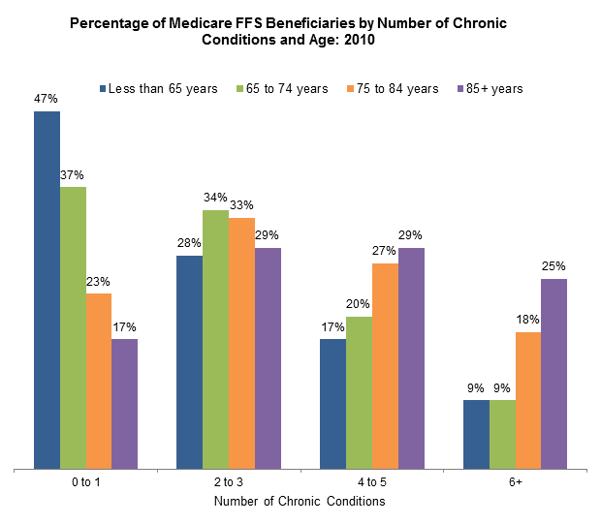
Notes:
Figure 1.2b.
Data highlights:
Over one half of beneficiaries less than 65 years had two or more chronic conditions compared to:
Sixty-three percent of those 65-74 years,
Seventy-eight percent of those 75-84 years and,
Eighty-three percent of beneficiaries 85 years and older.

Slide 16
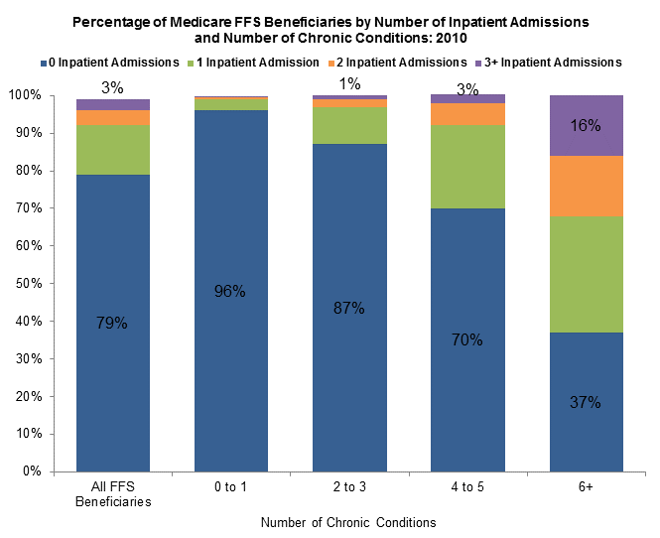
Notes:
Figure 2.1.
Data highlights:
As the number of chronic conditions increased so did hospitalizations:
Only 4% of beneficiaries with 0 or 1 chronic condition were hospitalized and less than 1% were hospitalized 3 or more times during the year.
Almost two-thirds of beneficiaries with 6 or more chronic conditions were hospitalized and 16% had 3 or more hospitalizations during the year.

Slide 17
MACRA LEGISLATION VALUE BASED
April 27th, 2016 executive notice by the US Department of Health and Human Services issued key provisions to the Medicare Access and Summary CHIP Reauthorization Act of 2015, (MACRA). Bi-partisan legislation
MACRA replaced the 1997 Sustainable Growth Rate formula for determining Medicare reimbursement
MACRA provides a new approach in Medicare reimbursement based on value and quality care
US Department of Health and Human Services, 2016

Slide 18
MACRA LEGISLATION VALUE BASED
MACRA legislation is guided by CMS Quality Payment Program and directs two paths for Medicare reimbursement – beginning January 1, 2017
The Merit-based Incentive Payment System (MIPS), or the Advanced Alternative Payment Model (APM),
CMS predicts 88% of providers (physicians, nurse practitioners, physician assistants and certified nurse anesthetists) will be MIPS vs APM
CMS Quality Payment Program, 2016

Slide 19
MACRA LEGISLATION MIPPS
MIPPS, will replace the current Medicare measures used to determine quality and value:
The Physicians Quality Reporting System (PQRS),
Value Modifier Program (VM) and the;
Medicare Electronic Health Record (EHR) Incentive Program’s or Meaningful Use will be grouped together under MIPPS
US Department of Health and Human Services, 2016

Slide 20
MACRA LEGISLATION MIPPS
MIPPS ensures Medicare provider care is incentivized for quality, safe and efficient care through 4 categories:
Quality Performance
Replaces PQRS and VM, and responsible for 50% weight in the first year. Emphasis is on outcome measurements (6 measures in the certified CMS meaningful use EHR)
Centers for Medicare and Medicaid, 2016

Slide 21
MACRA LEGISLATION MIPPS
Advancing Care Information
Category supports the use of patient engagement, medication safety, patient access to EHR etc.,
Accounts for 25% of weight in the first year. The weight of this category may decrease as more providers and practices adopt EHR use.
Centers for Medicare and Medicaid Services, 2016

Slide 22
MACRA LEGISLATION MIPPS
Clinical Practice Improvement
Providers can select from over 90 proposed activities such as self-management, shared decision making, care coordination, patient safety checklists etc.
This category accounts for 15% weight in the first year
Centers for Medicare and Medicaid Services, 2016

Slide 23
MACRA LEGISLATION MIPPS
Resource Use
CMS calculates the weight of this category based upon claims data and accounts for 10% in the first year. This category replaces the VM.
Centers for Medicare and Medicaid Services, 2016

Slide 24
MEDICARE AND CMS: CHRONIC CARE MANAGEMENT (CCM)
CCM USE HITS 33 MEASURES UNDER QUALITY AND, 22 HIGH PRIORITY MEASURES:
FULFILLS CLINICAL PRACTICE IMPROVEMENT
ADDRESSES COST RESOURCE USE
ADVANCING CARE INFORMATION – THROUGH EHR

Slide 25
MEDICARE NON-FACE-TO-FACE ENCOUNTER
January 2015, CMS finalized separate payment for Chronic Care Management (CCM) services for non-face-to-face care
Payment for CCM CPT Code - 99490
Average reimbursement for CCM services is $42.60/ monthly. Regional dependent
Federal Register, 2014

Slide 26
CCM - CPT 99490 REQUIREMENTS
Patients must have two or more chronic conditions extending a year or more, or until the death of the patient
Chronic Care Management (CCM) services, requires at least 20 minutes of clinical staff time directed by a qualified health care professional, per calendar month
Centers for Medicare and Medicaid Services, 2015

Slide 27
CCM REIMBURSEMENT REQUIREMENTS
Access to care management services, 24 hours a day, 7 days a week
Develop and implement an individualized patient-centered care plan
Provide coordination and transitions in care between settings

Slide 28
CCM REIMBURSEMENT REQUIREMENTS
Provide coordination with home & community-based clinical service providers
Promote and provide communication between provider, patient and caregiver
Populate the Electronic Health Record with important patient data and sharing of care plan information

Slide 29
CCM -MEDICARE BENEFICIARY AGREEMENT
Inform patient on CCM services and obtain written agreement for services
One provider a month can provide CCM services
Can withdraw from services at anytime
Explain coinsurance and deductibles
Enrollment in CCM is documented in the EHR

Slide 30
MONTHLY CALL
Provide Consistent Care Coordination to establish relationship and familiarly with individual patient
Establish, review and modify patient-centered care plan – embedded in the EHR
Physical functioning, Cognitive Assessment, Social Determinants, Caregiver Support, Disease Exacerbations
Medication Adherence, Review Medical Management
PREMEDIX, use of practice phone numbers when making monthly calls

Slide 31
PRACTICE PROCESS

Slide 32
CCM BENEFITS: THE PATIENT
For Patients
Access to primary care provider 24/7
Monthly communication and review of health status
Ensure medication adherence and monitoring
Communicate changes in health status directly with the medical provider
Provides access to medical record and provides shared decision making between patient and provider
Provides a dynamic care plan that is up-to-date and relevant to patient condition

Slide 33
CCM BENEFITS: THE PROVIDER
For Providers
Promotes coordinated and comprehensive care
Individualizes patient-centered care plans
Reduces crisis-like care through ongoing communication and proactive disease management
Promotes coordinated and comprehensive care outside of the clinical setting
Provides patient satisfaction for 24/7 availability and prompt follow-up
Increases monthly reimbursement incentives

Slide 34
POLL QUESTIONARE
Do you currently utilize CCM incentive reimbursement in your practice setting?
Yes
No
Not yet, but we plan to in the next 1-2 years
Not sure

Slide 35
OUTSOURCING CCM
CMS allows for outsourcing and reduces the need for:
Staff training and time away from practice demands
Billing and reimbursement coding and expertise
Employing designated care coordinators
Budgeting for specialized staff and technology to meet the requirements of CCM
Inability to manage an unpredictable variation in patient volume
Monitoring patient-centered outcome measures
CONFIDENTIAL

Slide 36
OUTSOURCING CCM
WHAT ARE YOU WAITING FOR?
CCM IS 20 MONTHS INTO THE MAKING
IMPROVE CARE COORDINATION AND REDUCE DEBILITY, DISEASE EXACERBATION AND HOSPITAL ADMISSION

Slide 37
CCM INCENTIVE REIMBURSEMENT REVENUE
Chronic Care Management Services
~$42.60 per patient per month
Annual Wellness Visit Optimization
$172.00 Initial Visit
$111.00 Subsequent Visit
Estimated 80% of 50 Million Eligible Beneficiaries are not Taking Advantage of the Benefit
Centers for Medicare and Medicaid Services, 2016

Slide 38
INCENTIVE EXAMPLE
Average # of Medicare Patients/Provider (2 MDs)
Total # of Medicare Patients
% Eligible (2> conditions)
Eligible Medicare Patients
Target Enrollment %
Monthly # of Patients
CCM Reimbursement
Annual Revenue
Annual Cost
Cost
One Year Net-Gain
800
1,600
70%
1,120
40%
450
$42.60
$230,040
$129,600
56.34%
$100,400

Slide 39
2016 CMS CURRENT RULES FOR CCM
CMS currently reimburses CCM codes (99487 & 99489) and addresses “complex” care needs
99487: 60 minutes of clinical staff by required providers per calendar month
99489: Additional 30 minutes of clinical staff time per calendar month
Initiating visit required for new patients or patients not seen within one calendar year
Centers for Medicare and Medicaid Services, 2016

Slide 40
2017 CMS PROPOSED RULES FOR CCM
Removing the requirement for 24/7 access to care plan by CCM providers
No longer required to standardize content for continuity of care document
Beneficiary consent can be obtained without a written agreement
New “add-on G-code” to add payments for provider led care planning
General supervision allowed for rural health clinics and FQHCs
Federal Registrar, 2016

Slide 41
POLL QUESTION
How prepared are you to engage your patients in CCM?
Totally prepared, workflows are in place
Somewhat prepared, need to train
Not prepared
Not sure

Slide 42
Thank you!
www.multiplechronicconditions.org
www.premedex.com

