Slide 1
DIFFERENTIATING SPINAL PAIN
DR. KIM KUEBLER DNP, APRN, ANP-BC, FAAN

Slide 2
“PAIN IS WHATEVER THE EXPERIENCING PERSON SAYS IT IS”
McCaffery, 1969

Slide 3
TYPES OF PAIN
ACUTE
CHRONIC
SOMATIC/INFLAMMATORY
NEUROPATHIC/NERVE
MIXED
DISCOGENIC

Slide 4
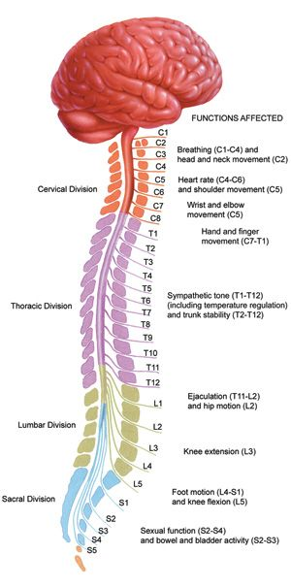
MEMORY OF PAIN

Slide 5
MULTIDIMENSIONAL

Slide 6
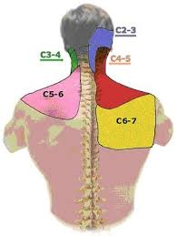
INFLAMMATION FACET

Slide 7
MEDIAL NERVE BRANCH FACET JOINT

Slide 8
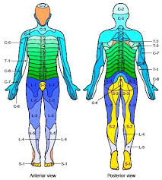
NEUROPATHIC PAIN
NEUROPATHIC PAIN:
NERVE FIRING/SCIATICA/RADICULAPTHY
DERMATOMES
INFLAMMATION
MUSCLE WEAKNESS
STENOSIS (FORAMINAL. CENTRAL CANAL)
TFESI, Caudal, Intralaminar

Slide 9
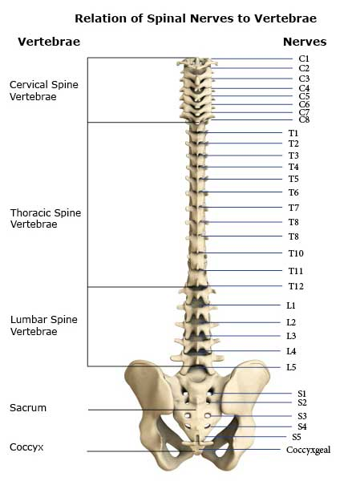
DERMATOMES

Slide 10
FORAMINAL STENOSIS

Slide 11
CENTRAL CANAL STENOSIS

Slide 12
SPINAL CORD COMPRESSION SERIOUS

Slide 13
REFERENCES
Kuebler, K., & Oskouei, A (2020). Collaborating With a Spinal Interventionalist in the Management of Low Back Pain. Journal of the Nurse Practitioner, 16(1), 23-27.
Kuebler, K., Arcure, J., & Oskouei, A. (2021), Diagnosing and Managing Spinal Stenosis. Journal of the Nurse Practitioner, 17(9), 1068-1070
McCartney, S., Baskerville, R., Blagg, S., & McCartney, D. (2018). Cervical Radiculopathy and Cervical Myelopathy. British Journal of General Practice, 68, 44-46.

